Slide 1
STAT 4830 · SPRING 2026
Lower Bounds for the
Autoconvolution Constant
Three parallel attacks on C₁ₐ
Andrei Piterbarg Jai Bajaj Derrick Vincent
I. Cascade
II. SDP certificate
III. MATLAB audit

Slide 2
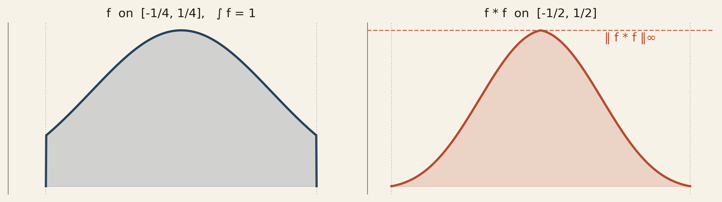
§1 · THE PROBLEM
How small can the peak of a normalized self-convolution be?
Given f : ℝ → ℝ₊ with supp f ⊆ [−¼, ¼]
and ∫ f = 1, define
C₁ₐ = inf ‖ f ∗ f ‖∞
· connected to Sidon / generalized Sidon set densities
· best published bounds have not moved since 2017
· every improvement is a real contribution
BEST PUBLISHED BOUNDS
1.2802 ≤ C₁ₐ ≤ 1.5029 unchanged since 2017
Piterbarg · Bajaj · Vincent STAT 4830 — Spring 2026

Slide 3
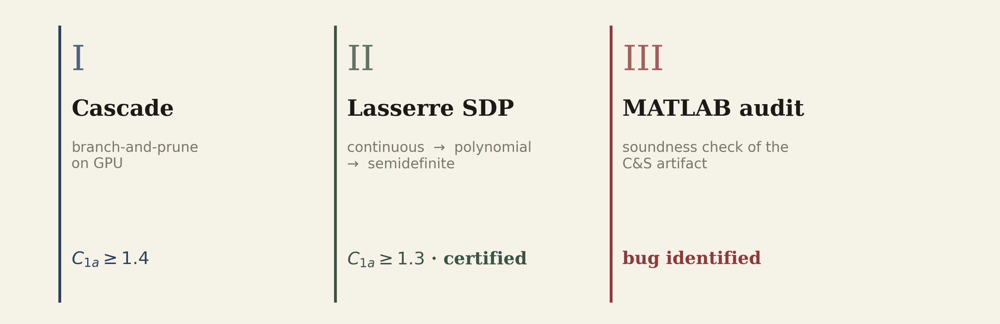
§2 · BASELINE AND OUR THREE TRACKS
Three independent attacks above the 2017 floor
PRIOR WORK — CLONINGER & STEINERBERGER 2017
PUBLISHED RESULT
Branch-and-prune over the fine height grid Bn,m: discretize [−¼, ¼] into d = 2n bins,
enumerate height vectors and prune any whose windowed test value exceeds the target; correction term 2/m + 1/m².
C₁ₐ ≥ 1.2802
(n, m) = (24, 50) · ≈ 20,000 CPU-hours
OUR CONTRIBUTION — THREE INDEPENDENT TRACKS
Piterbarg · Bajaj · Vincent STAT 4830 — Spring 2026

Slide 4
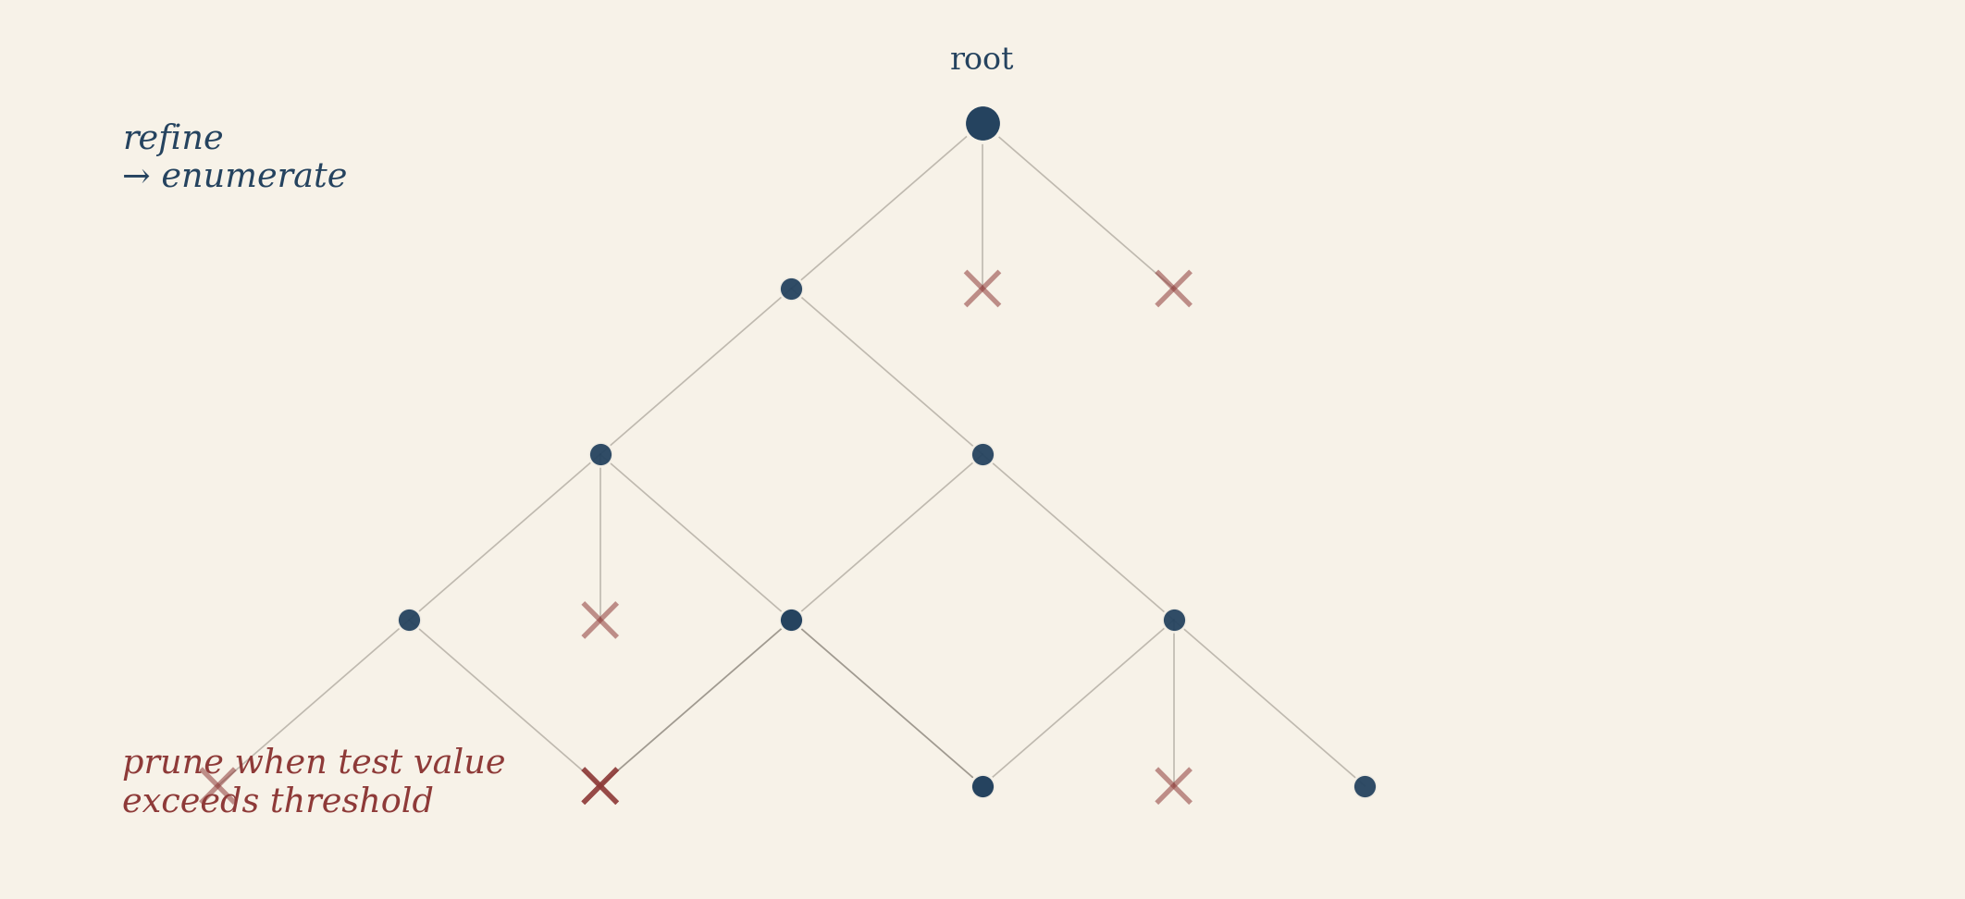
TRACK I · CASCADE
Recursive refinement with novel pruning, fused GPU kernels
Novel pruning bounds
· contiguous-block sums catch interior concentrations
· two-max enhanced bound — cross-term dominance
· edge-pair cross-terms c₀ · c_{d−1}
each bound proved, then compiled into the pruner
Fused CUDA kernel
· everything on-GPU; no global-memory round trips
· early exit on partial convolution sums (most compositions die cheap)
· two-stage freeze kernel at deep levels — perturbation bound
clears 90 %+ of frozen cases, avoiding warp divergence
· 10 × – 100 × speedup over the naive enumerator
Piterbarg · Bajaj · Vincent STAT 4830 — Spring 2026

Slide 5
TRACK I · RESULT
Cascade pushes the lower bound from 1.2802 to 1.4
CASCADE · GPU
TRADE-OFFS
C₁ₐ ≥ 1.4
What the cascade buys you
· sharp in principle — exhaustive enumeration rules out every surviving point
· scales to d = 128 via symmetry reduction + GPU pruning
What it doesn't
· exponential in d in the worst case
· correctness rides on many small inequalities — each needs a proof
· motivated us to build a second, independent certifier …
at (d, m) = (128, 20)
≈ 70 hours on a 128-core machine
First significant lower-bound improvement since 2017.
Gap to upper bound narrowed by ≈ 50 % (0.22 → 0.10).
Piterbarg · Bajaj · Vincent STAT 4830 — Spring 2026

Slide 6
TRACK II · LASSERRE SDP
Continuous → polynomial → semidefinite (no enumeration)
1. Reduce the infinite-dimensional problem on 𝓕 to a polynomial minimization on the simplex:
val(d) = minᵤ ∈ Δ_d max_W μᵀ M_W μ ≤ C₁ₐ
2. Relax via the Lasserre hierarchy with localizing matrices:
val⁽ᵏ⁾(d) ≤ val⁽ᵏ⁺¹⁾(d) ≤ val(d)
3. Certify a dual-feasible point of the order-k SDP whose objective exceeds the threshold.
Scaling lever — correlative sparsity (Waki–Kim–Kojima–Muramatsu 2006).
Chordal extension of the banded window graph yields O(d) overlapping cliques; the dense binom(d+k, k) moment matrix is replaced by O(d) small blocks.
Piterbarg · Bajaj · Vincent STAT 4830 — Spring 2026

Slide 7
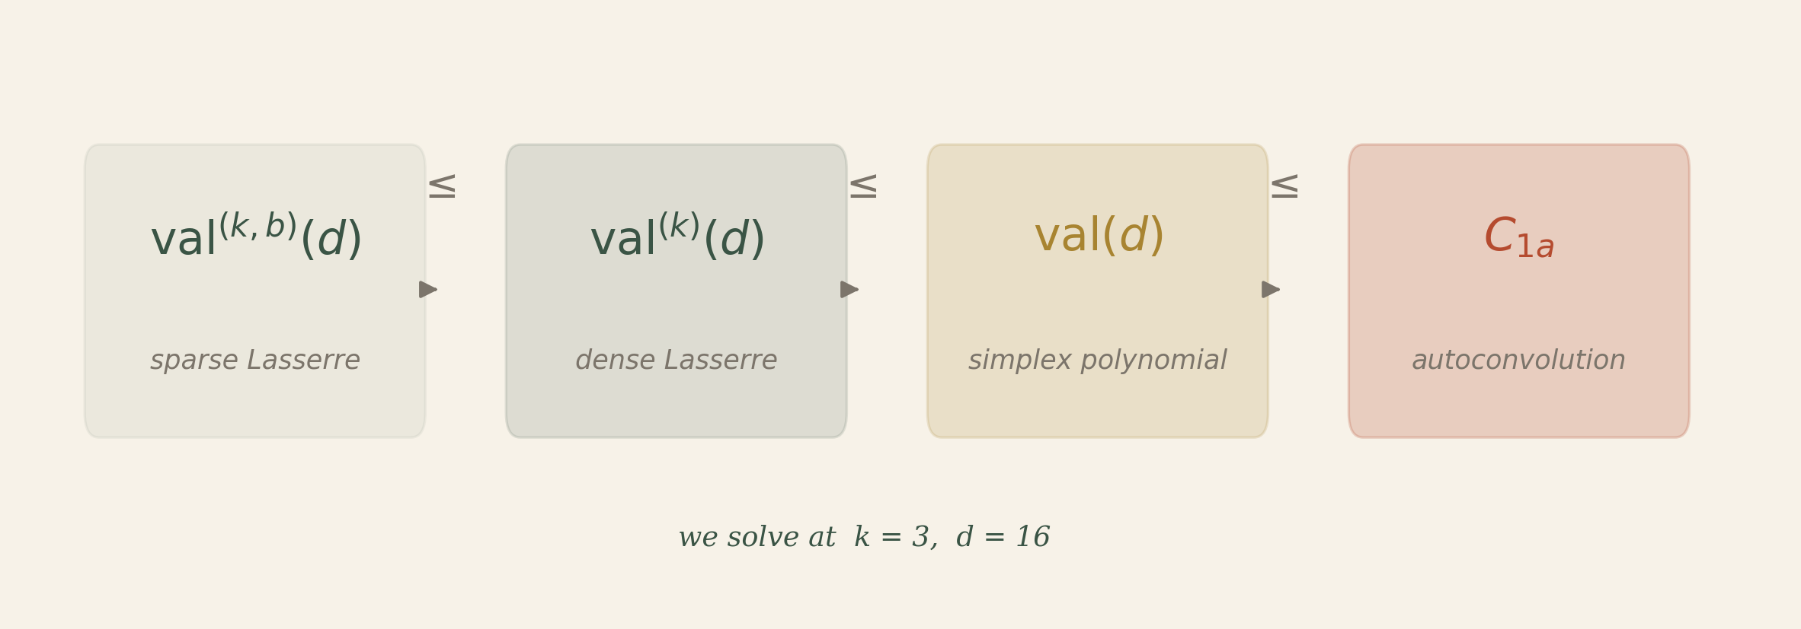
TRACK II · RESULT
A certified lower bound with full rigor
CERTIFIED
C₁ₐ ≥ 1.3
at (d, k) = (16, 3)
MOSEK · < 10 minutes
What we record
· a single dual-feasible point (y, Z, Λ)
· post-processed via Jansson–Chaykin–Keil
interval-arithmetic shift
· auxiliary runs at d ∈ {32, 64, 128}
under correlative sparsity
Piterbarg · Bajaj · Vincent STAT 4830 — Spring 2026

Slide 8
TRACK III · AUDITING THE C&S MATLAB
The code the authors shared — what it does
When we set out to reproduce the C₁ₐ ≥ 1.2802 baseline we ran the MATLAB file
Cloninger and Steinerberger shared (original_baseline_matlab.m). The published C&S paper is correct —
it uses the fine height grid Bn,m with m = 50.
The MATLAB file, though, parameterizes the search differently:
In the paper: step-function heights quantized in steps of 1/m = 0.02
In the code: bin masses quantized in steps of 0.02 → heights quantized in steps of 2d × 0.02
Different parameterization. Different height step. Same correction formula.
Piterbarg · Bajaj · Vincent STAT 4830 — Spring 2026

Slide 9
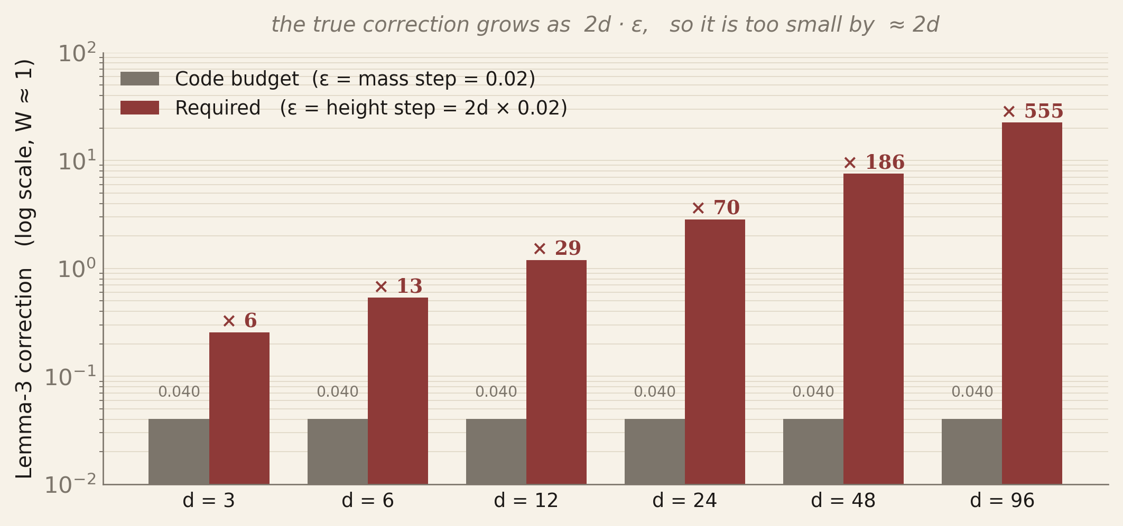
TRACK III · THE GAP
Lemma 3 needs the height step; the code plugs in the mass step
C&S Lemma 3 gives
(g ∗ g)(x) ≤ (a ∗ a)(x) + 2ε + ε²
where ε is a bound on ‖g − a‖∞ (a height difference).
In the MATLAB code
ε = 0.02 (mass step), but heights hᵢ = 2d · massᵢ,
so the true ‖g − a‖∞ ≤ 2d × 0.02, not 0.02.
The code's pruning budget is too small by a factor of
≈ 2d.
Piterbarg · Bajaj · Vincent STAT 4830 — Spring 2026

Slide 10
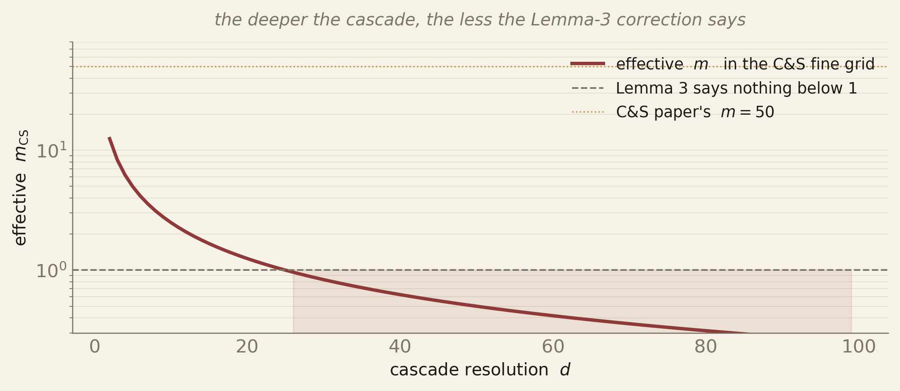
TRACK III · THE CONSEQUENCE
The code would "prove away" a known construction
The check
Matolcsi–Vinuesa (2010) exhibit a continuous f* with
‖f* ∗ f*‖∞ ≤ 1.5029.
So C₁ₐ ≤ 1.5029.
Point the MATLAB cascade at the threshold 1.51:
· interior-window budget stays at ≈ 0.04 across levels
· the step-function approximation of f* has self-convolution peaks
that exceed 1.55 on narrow windows at moderate d
· the code therefore prunes every descendant of f*
· exhausted survivors → claim: C₁ₐ ≥ 1.51
But 1.51 > 1.5029 ≥ C₁ₐ. Contradiction.
The effective fine-grid m in C&S units is 1 / (2dε) — it drops below 1 by d ≈ 25, at which point Lemma 3 says nothing at all.
Piterbarg · Bajaj · Vincent STAT 4830 — Spring 2026

Slide 11
TRACK III · WHAT WE ARE SAYING
The paper stands; the shared MATLAB file does not prove it
THE PAPER IS FINE
TWO LIVE HYPOTHESES
C&S 2017 work on the fine height grid Bn,m,
where Lemma 3's 2/m + 1/m² correction is legitimate.
The published bound 1.2802 is not in doubt.
The MATLAB artifact is a different animal:
it enumerates a coarser mass grid, but ports the paper's
correction formula verbatim. That combination
cannot certify the paper's bound, and as shown would
certify bounds that contradict the MV upper bound.
(a) They sent us an early prototype.
The published bound was run on a separate fine-grid
enumerator; the coarse-mass file is a speed-oriented
variant never meant to be the proof vehicle.
(b) A derivation we're missing.
A mass-space bound that avoids the 2d factor —
unlikely, but worth asking about before we conclude.
Either way, this is a narrow claim about one file.
We fixed the analogous bug in our own Python port on 2026-04-07 — switched to the fine grid, which is what makes the cascade's 1.4 sound.
Piterbarg · Bajaj · Vincent STAT 4830 — Spring 2026

Slide 12
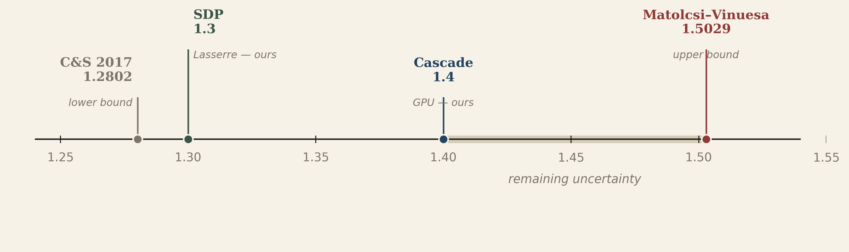
§3 · TAKEAWAYS
Where C₁ₐ stands after this project
THREE DELIVERABLES
I. Cascade on GPU — C₁ₐ ≥ 1.4 via novel pruning bounds + fused CUDA kernels.
II. Lasserre SDP certificate — C₁ₐ ≥ 1.3 (certified) at (d, k) = (16, 3) in under 10 minutes.
III. MATLAB audit — the shared C&S artifact confuses the mass step for the height step; the published paper is unaffected.
Next: formal write-ups for both proofs in proof/, push cascade to d ≥ 256, close the gap toward 1.5029.
Piterbarg · Bajaj · Vincent STAT 4830 — Spring 2026

